Slide 1
Effectiveness of the database
ABDUL RAHEEM RIHAM AHAMED
HND COMPUTING IDM

Slide 2
Table of contents
User requirements
System requirements
Primary system requirements
Secondary system requirements
Tertiary system requirements
Tables
Why evidence to prove effectiveness?
Encrypt Data while performing CRUD.
Use Reporting services to visualize data
Host the database separate from the application and use a REST API to query data
Navigate from SQL to NoSQL
Reference

Slide 3
User requirements
The following criteria is applicable to all users:
Have a history of decent exposure to other well-known application software.
Must strictly remain within their scope of action.
Have a primary sense of reporting any and all strange behaviors to the school’s IT staff.
Must obey all school practices.
Notes:
Users have been categorized to 3 groups, depending on the role they have to perform in order to extract the best of the system. Namely, Admins, Consumers and Supporters.
The roles and abilities of each user type:
Admin users: have read/write permissions, can change passwords of consumers and other admins, can create consumer accounts, can backup & restore the database and can completely erase all data within the database.
Consumer users: have read/write permissions for all forms across the system.
Support users: do not interact with the system at all. They exist in order to ensure that the system functions well and to serve the purpose of reporting management level or the IT staff when an error of sufficient magnitude has occurred.

Slide 4
System requirements
Operating system requirements.
Windows 10 (64-bit) version 1607 (10.0.14393) or later
Windows 8.1 (64-bit)
Windows Server 2019 (64-bit)
Minimum System requirements.
1.8 GHz or faster x86 (Intel, AMD) processor. Dual-core or better recommended
2 GB of RAM; 4 GB of RAM recommended (2.5 GB minimum if running on a virtual machine)
Hard disk space: Minimum of 2 GB up to 10 GB of available space

Slide 5
Primary system requirements
Trinity expects and have been provided with a database that can keep records of:
Trinity expects and is provided with a database of records:
Classes.
Teachers who teach in a class.
Students participating in a class.
Instrument rented for a specific class.

Slide 6
Secondary system requirements
Trinity expects and have been provided with a database that has the following tables:
Class records must contain ClassID, Start_Date, End_Date, Fees, StudentID, TeacherID, InstrumentID attributes.
Instrument records must contain instrumentID, Name, Quantity, Rental_Price, ClassID, SupplierID attributes.
Student records must contain StudentID, Name, Type, DOB, Register_Date, Contact_Number, ClassID attributes.

Slide 7
Tertiary system requirements
Trinity expects and is provided with the following implementations:
Activate each type of musical instrument offered by only one company.
Execute the rental formula as “NumberOfInstruments * Period”.
There can be many students if one class is implemented.
A student can have multiple classes.
Enable student classification of "full_time" and "part-time" categories.
A teacher can have multiple classes.
There can be many teachers if one class is implemented.

Slide 8
Class Table
ClassID | Start_Date | End_Date | Feees | TeacherID | StudentID | IntrumentID
0001 | 2021-04-04 | 2021-10-04 | 5000.00 | 0001 | 0005 | 0001
0002 | 2021-04-04 | 2021-12-04 | 10000.00 | 0002 | 0004 | 0003
0003 | 2020-04-04 | 2021-04-04 | 15000.00 | 0003 | 0003 | 0002
0004 | 2021-03-04 | 2021-09-04 | 3000.00 | 0004 | 0002 | 0005
0005 | 2021-03-04 | 2021-12-04 | 5000.00 | 0005 | 0001 | 0004

Slide 9
Student Table
StudentID | Name | Type | DOB | Register_Date | Contact_NO | ClassID
0001 | Ajith | Full Time | 1999-08-05 | 2021-04-04 | 777535753 | 0001
0002 | Karthi | Part Time | 1996-08-07 | 2021-04-04 | 757414741 | 0002
0003 | Vijay | Part Time | 1999-12-05 | 2021-05-04 | 728525852 | 0003
0004 | Kavin | Full Time | 1998-04-05 | 2021-04-04 | 714565456 | 0004
0005 | Sarath | Part Time | 1989-08-03 | 2021-03-04 | 787896541 | 0005

Slide 10
Teacher Table
TeacherID | Name | Contact_NO | ClassID
0001 | Alison | 774565159 | 0005
0002 | Bella | 774565159 | 0004
0003 | Faith | 774565159 | 0003
0004 | Vikram | 774565159 | 0002
0005 | Surya | 728965742 | 0001

Slide 11
Instrument Table
InstrumentID | Name | Quantity | Rental_Price | ClassID | SupplierID
0001 | Piano | 5 | 15000.00 | 0001 | 0001
0002 | Keyboard | 3 | 10000.00 | 0003 | 0002
0003 | Organ | 7 | 25000.00 | 0002 | 0003
0004 | Saxophone | 10 | 15000.00 | 0005 | 0005
0005 | Maracas | 2 | 7000.00 | 0004 | 0004

Slide 12
Supplier Table
SuplierID | Name | Address | Contact_No | InstrumentID
0001 | Mark | Colombo | 777414741 | 0001
0002 | Villiyam | Ampara | 778965236 | 0002
0003 | Josh | Galle | 771245874 | 0003
0004 | Albert | Jafna | 779636963 | 0005
0005 | Babej | Vavuniya | 778525852 | 0004

Slide 13
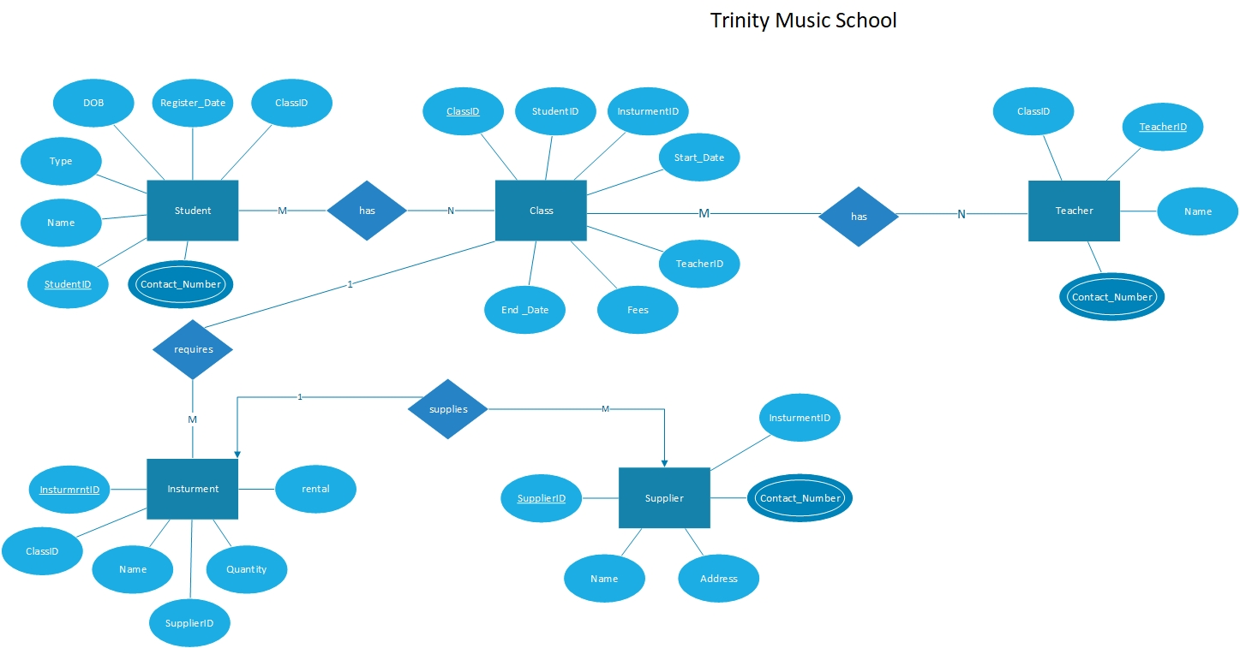
ER DIAGRAM
Notes:
The organizational Entity Relationship diagram (ERD) was used as a modeling technique to model the database. During the modeling phase, 5 different Entity and their characteristics were identified according to the visual and stated needs of the school. On closer inspection, it was found that these companies have relationships between them. After a thorough study, the relationships were determined and properly mapped.

Slide 14
Why evidence to prove effectiveness?
This allows users of both technical and non-technical fields to grasp how powerful this solution is.
As the database solution is not simplistic, the most rational way to demonstrate how effectively the user and system requirements have been captured is to first explain the user and system requirements and then provide evidence that the solution has fulfilled these requirements through implementation.
Notes:
The database solution was built on a version of SQL server compatible with on Windows, as such it will not run on operating systems like MacOS, GNU/Linux, FreeBSD etc.
By minimum 512 MB of RAM is required, in order for visualization atleast 16 MB of VRAM is also required.
The processor could go below the specified generation and clock speed but performance will degrade appropriately.

Slide 15
Encrypt Data while performing CRUD.
Doing so will minimize security issues and keep users that have accessed the database without the authority to do so from using the data elsewhere or cause any financial damage to Trinity.
Recommendation: AES 256 encryption algorithm. It is easy to implement and difficult to break so security is ensured while having maximum performance
Notes:
The database solution was built on a version of SQL server compatible with on Windows, as such it will not run on operating systems like MacOS, GNU/Linux, FreeBSD etc.
By minimum 512 MB of RAM is required, in order for visualization atleast 16 MB of VRAM is also required.
The processor could go below the specified generation and clock speed but performance will degrade appropriately.

Slide 16
Use Reporting services to visualize data
This will allow admins to extract data, visualize them in reports and help management departments to make decisions about Trinity’s future.
Recommendation: SAP Crystal Reports Reporting service, at a cheap cost dynamic and extremely informative reports can be created.
Notes:
The database solution was built on a version of SQL server compatible with on Windows, as such it will not run on operating systems like MacOS, GNU/Linux, FreeBSD etc.
By minimum 512 MB of RAM is required, in order for visualization atleast 16 MB of VRAM is also required.
The processor could go below the specified generation and clock speed but performance will degrade appropriately.

Slide 17
Host the database separate from the application and use a REST API to query data
This will not only boost security and ensure minimal system failure but also allow centralization of the database, so companies all over the world can interact with Trinity’s API to request data that could lead to expanding Trinity’s wings.
Recommendation: Cloud services or specialized database server hosting. For a very low price, centralization, security and 24/7 support is established. Or else locally host a database server.
Notes:
The database solution was built on a version of SQL server compatible with on Windows, as such it will not run on operating systems like MacOS, GNU/Linux, FreeBSD etc.
By minimum 512 MB of RAM is required, in order for visualization atleast 16 MB of VRAM is also required.
The processor could go below the specified generation and clock speed but performance will degrade appropriately.

Slide 18
Navigate from SQL to NoSQL
Trinity’s data schemas are yet too immature and very unstructured. A single student or teacher may have properties or data unique to him/her or classes may have properties that might have specialized attributes to it.
In cases of immature data schemas and when a company is moving from traditional storage to databases, NoSQL database solutions are ideal.
Recommendation: MongoDB, a robust, server-based and highly performant NoSQL DBMS that is popular world-wide and is used to solve the above mentioned problems.
Notes:
The database solution was built on a version of SQL server compatible with on Windows, as such it will not run on operating systems like MacOS, GNU/Linux, FreeBSD etc.
By minimum 512 MB of RAM is required, in order for visualization atleast 16 MB of VRAM is also required.
The processor could go below the specified generation and clock speed but performance will degrade appropriately.

Slide 19
Reference
Guru99, 2021. What is Normalization? 1NF, 2NF, 3NF, BCNF Database Example. [Online] Available at: https://www.guru99.com/database-normalization.html [Accessed 04 04 2021].
Microsoft, 2021. Download SQL Server Management Studio (SSMS). [Online] Available at: https://docs.microsoft.com/en-us/sql/ssms/download-sql-server-management-studio-ssms?view=sql-server-ver15 [Accessed 04 04 2021].
Springs, S., 2021. subjectguides. [Online] Available at: https://subjectguides.esc.edu/researchskillstutorial/primary#:~:text=Data%20from%20an%20experiment%20is,one%20step%20removed%20from%20that.&text=Tertiary%20sources%20summarize%20or%20synthesize,reference%20books%20are%20tertiary%20sources. [Accessed 04 04 2021].
tutorialspoint, 2021. TUTORILASPOINT_SIMPLYEASYLEARNING. [Online] Available at: https://www.tutorialspoint.com/uml/uml_use_case_diagram.htm [Accessed 04 04 2021].

Slide 20
THANK YOU

